Slide 1
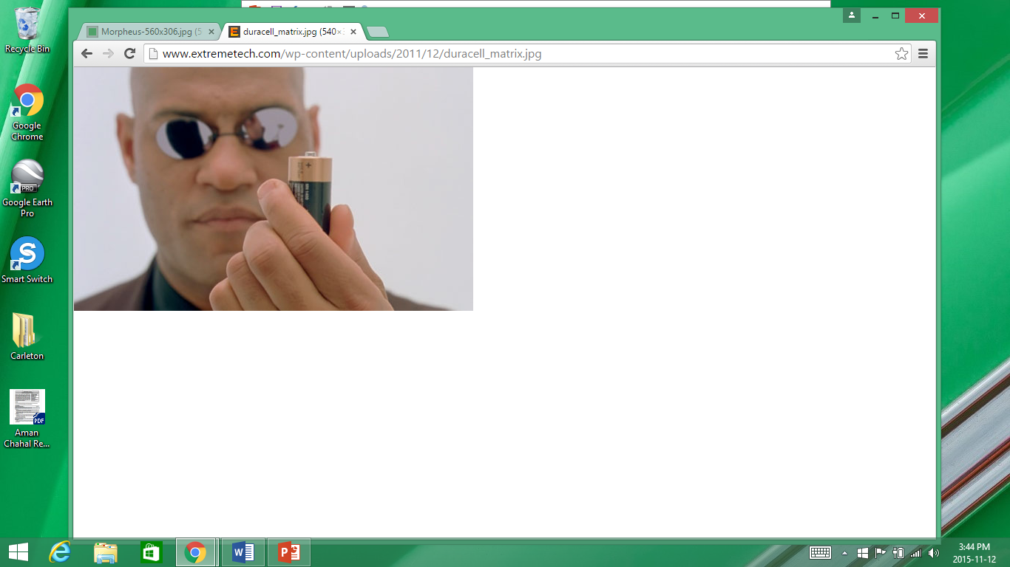

Slide 2

The Lithium-Ion Battery Modelling Challenge: A Dynamic Systems and Control Perspective
Authors: Donald J. Docimo, Mohammad Ghanaatpishe, Michael J. Rothenberger, Christopher D. Rahn and Hosam F. Fathy. Pennsylvania State University
Presentation: Aman Chahal

Slide 3

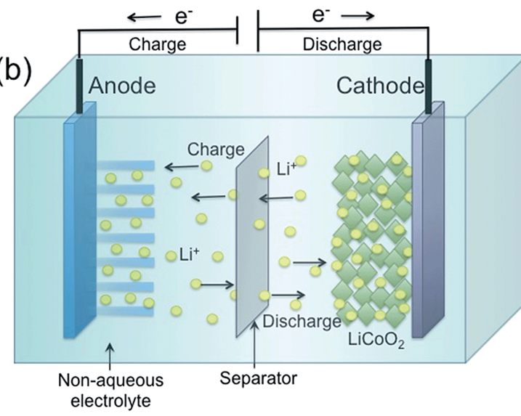
What is a Battery?
A battery is a device in which chemical energy can be stored that can later be converted to electrical energy to do work
A battery contains 3 main components
1. Anode (Negative electrode)
- Electrons flow out of the anode
2. Cathode (Positive Electrode)
- Electrons flow towards the cathode
3. Electrolyte
- Contains ions that are needed to balance the reaction,
As electrons move and work is done, the battery discharges and loses its potential difference
Separator isolates the anode and the cathode and prevents short circuits

Slide 4
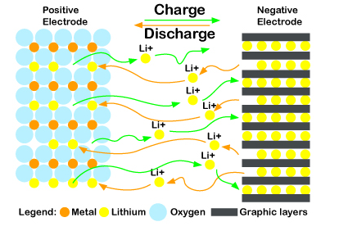
Electrode
Electrode Layers

Slide 5
Lithium Ion Battery Challenges
Solid Electrolyte Interphase Growth (SEI)
Lithium plating
Mechanical Degradation
Thermal Runaway
Notes:
http://pubs.rsc.org/services/images/RSCpubs.ePlatform.Service.FreeContent.ImageService.svc/ImageService/Articleimage/2015/TA/c4ta04980b/c4ta04980b-f4_hi-res.gif

Slide 6
1. Solid Electrolyte Interphase Growth (SEI)
Build up of Lithium Ions
Consequences:
Reduce the ability of the battery to produce a high level of power.
Causes
- Temperature

Slide 7
2. Lithium plating
Growth of a lithium ion dendrite, ‘branch’ pierces the separator
Consequences:
Causes a short circuit in the battery
Causes
- Temperature

Slide 8
3. Mechanical Degradation
Consequences:
Lithium ions embedded in the electrodes with cause them to expand and contract with the charge/discharge cycles
Results in mechanical failure
Causes
- Deep charge/ discharge cycles (discharging most of the capacity before recharging)

Slide 9
4. Thermal Runoff
Consequences:
Battery quickly heats up, catastrophic failure (fire). Can have cascade effect
Causes
- Pre-existing conditions like SEI growth

Slide 10
Battery Management System
Battery management systems that use electrochemistry to understand battery health and manage battery life can:
Increase Battery Life
Increase Battery Performance
Increase Battery Efficiency
Increase Safety
Analyzed DFN modelling system and Ohm modelling- no clear winners
Notes:
http://pubs.rsc.org/services/images/RSCpubs.ePlatform.Service.FreeContent.ImageService.svc/ImageService/Articleimage/2015/TA/c4ta04980b/c4ta04980b-f4_hi-res.gif

Slide 11
Questions?
Notes:
http://pubs.rsc.org/services/images/RSCpubs.ePlatform.Service.FreeContent.ImageService.svc/ImageService/Articleimage/2015/TA/c4ta04980b/c4ta04980b-f4_hi-res.gif

